Slide 1
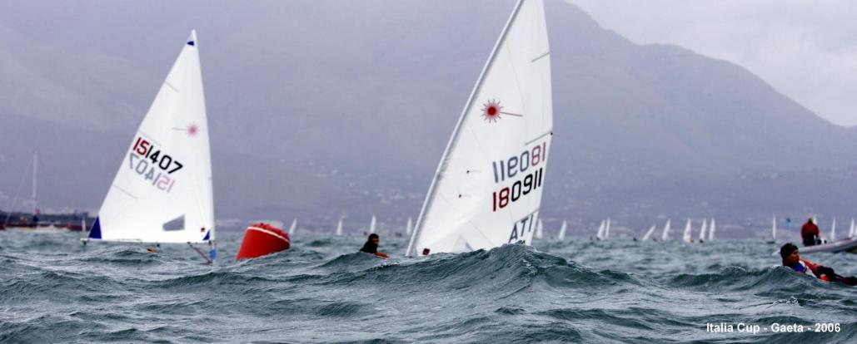
Rule 42 course - 382 exercises
Updated 18/11/2024
This presentation was written by Ezio Fonda. The videos in this Power Point have been made by the author, by colleagues or taken from publicly accessible websites. If a competitor wants to remove a video which they are in, please send an email to www@eziofonda.it

Slide 2
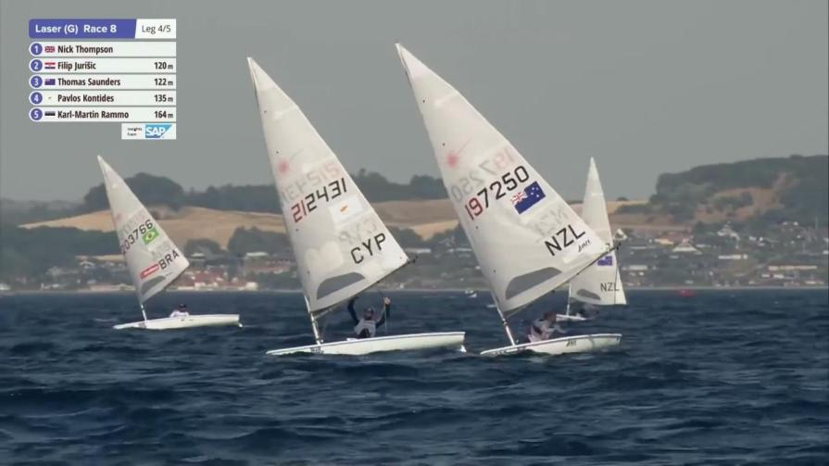
00001

Slide 3
Rock 7 | 42.2(b) | Repeated rolling not linked to wave patterns
00001

Slide 4
00002

Slide 5
00002

Slide 6
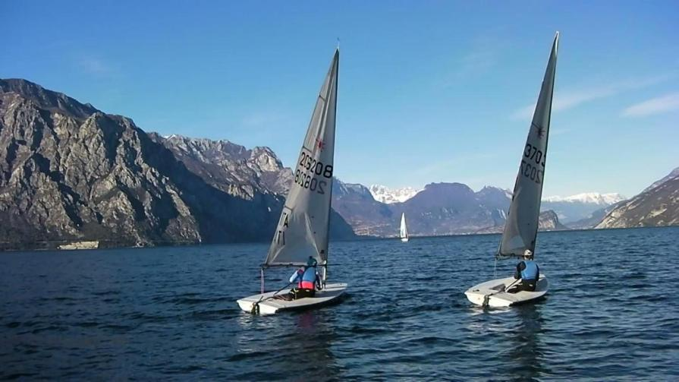
00003

Slide 7
00003

Slide 8
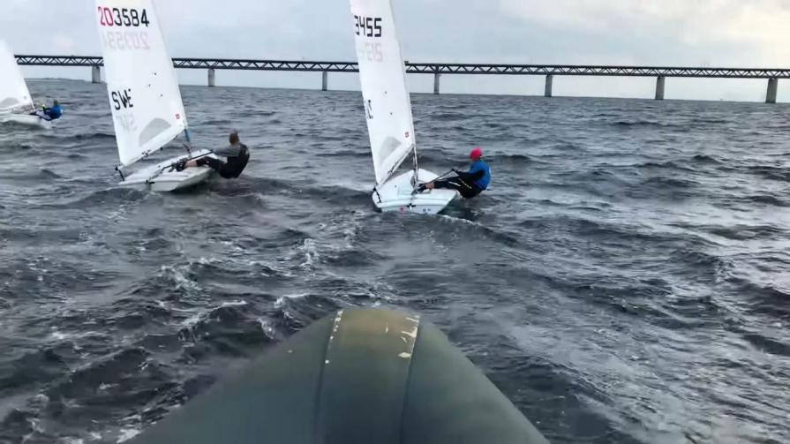
00004

Slide 9
00004

Slide 10
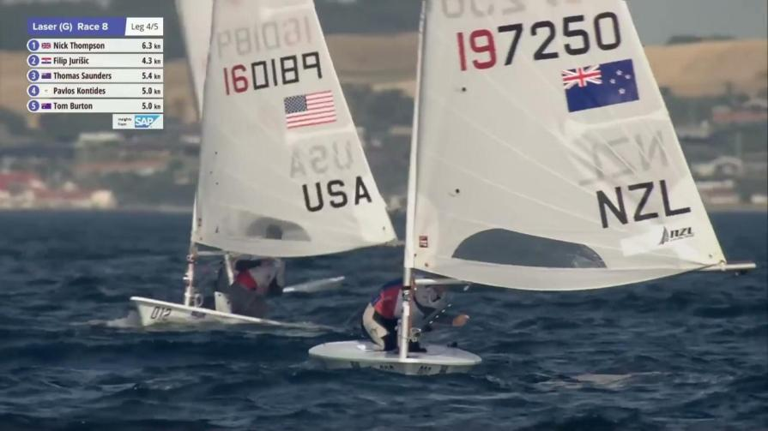
00005

Slide 11
Rock 7 | 42.2(b) | Repeated rolling not linked to wave patterns
00005

Slide 12
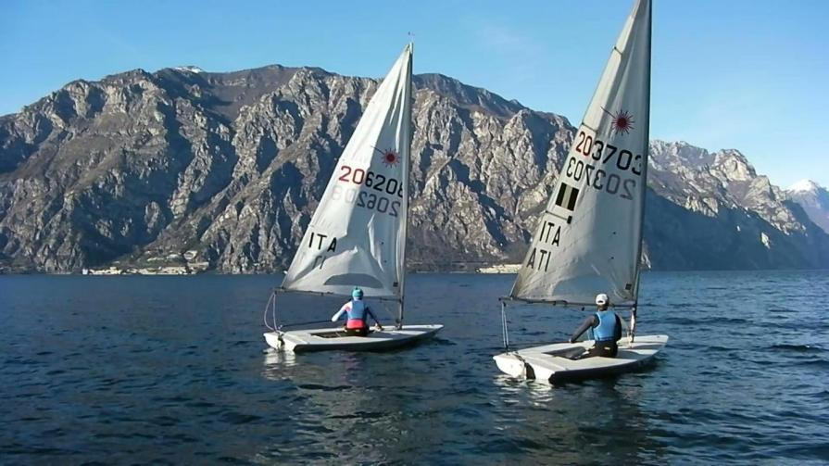
00006

Slide 13
 | 42.2(d) | Sculled below close-hauled.
00006

Slide 14
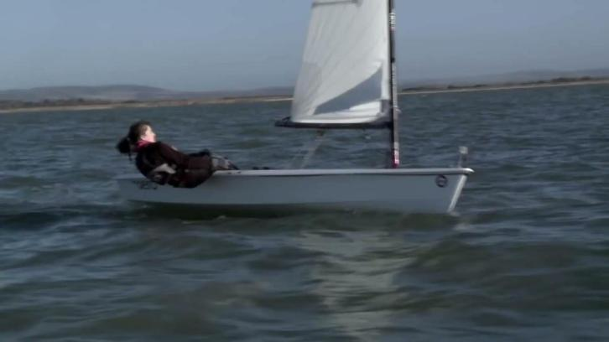
00007

Slide 15
Basic 6 | 42.1 | After a tack when a boat is on her new close-hauled course, body movement clearly propelling the boat is prohibited under rule 42.1.
00007

Slide 16
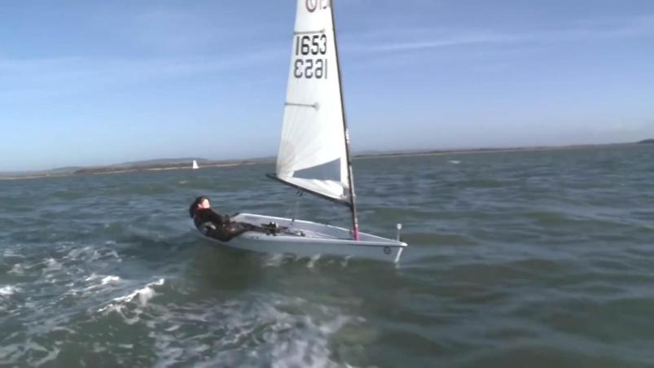
00008

Slide 17
Basic 6 | 42.1 | After a tack when a boat is on her new close-hauled course, body movement clearly propelling the boat is prohibited under rule 42.1.
00008

Slide 18
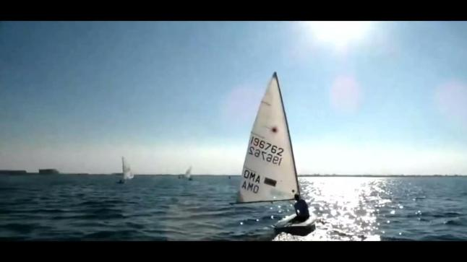
00009

Slide 19
Rock 6 | 42.2(b) | Heeling to windward to facilitate bearing away and heeling to leeward to facilitate heading up are permitted. The heeling of the boat has to be consistent with the boat’s turn.
00009

Slide 20
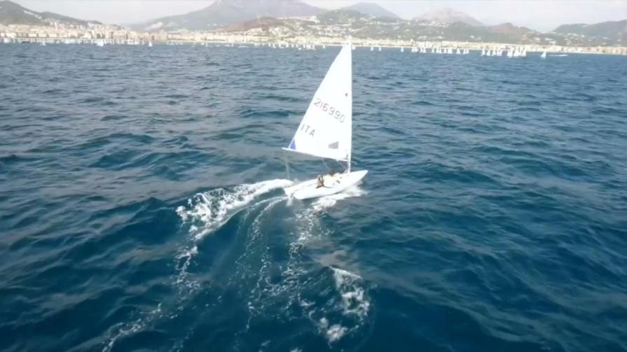
00010

Slide 21
00010

Slide 22
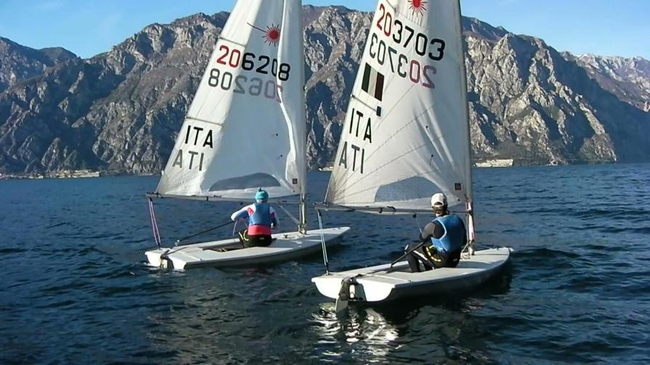
00011

Slide 23
Scull 2 | 42.2(d) | After a boat has sculled in one direction, further connected sculling to offset the first sculling action is prohibited.
00011

Slide 24
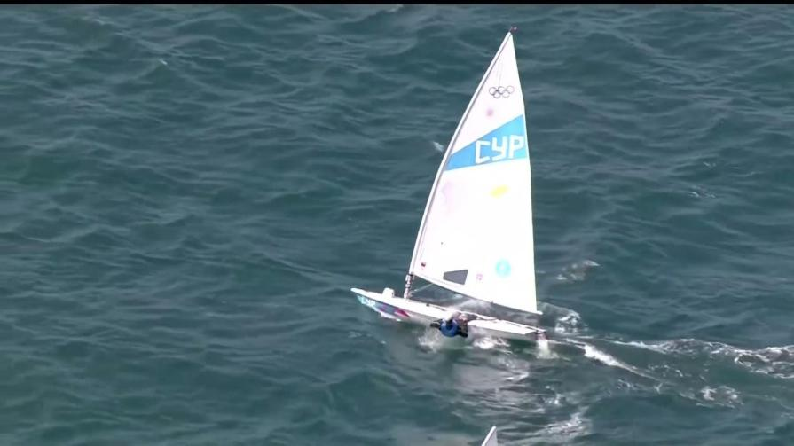
00015

Slide 25
00015

Slide 26
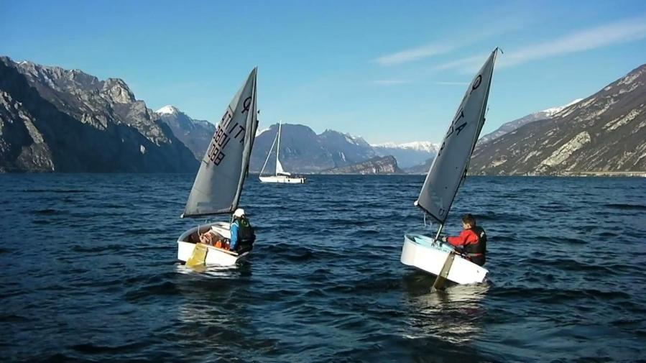
00012

Slide 27
Scull 2 | 42.2(d) | After a boat has sculled in one direction, further connected sculling to offset the first sculling action is prohibited.
00012

Slide 28
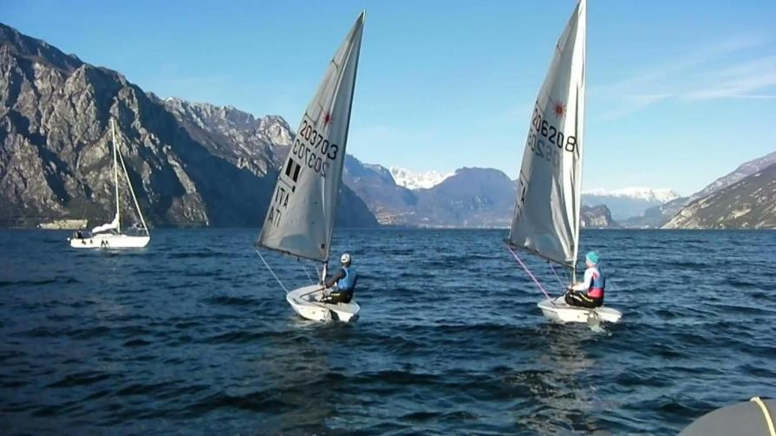
00013

Slide 29
 | 42.2(d) | Sculled below close-hauled.
00013

Slide 30
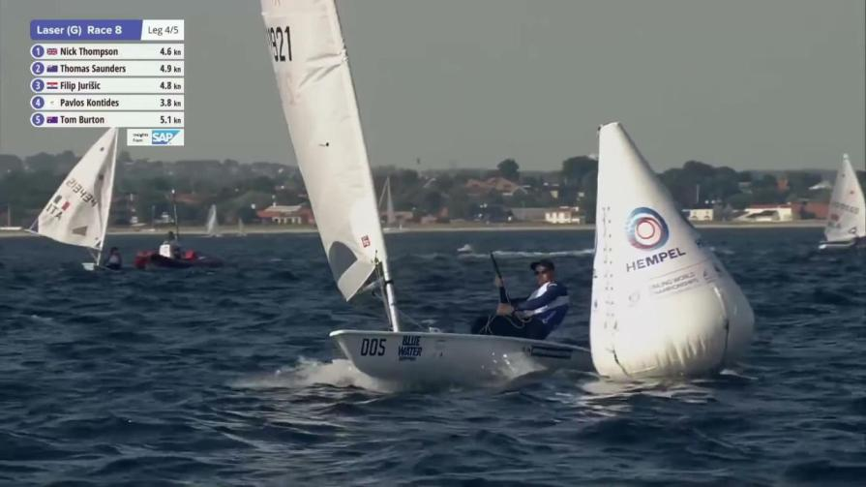
00014

Slide 31
Pump 12 | 42.2(a) | The exception in rule 42.3(c)(1) does not apply to a boat that is already surfing or planing.
00014

Slide 32
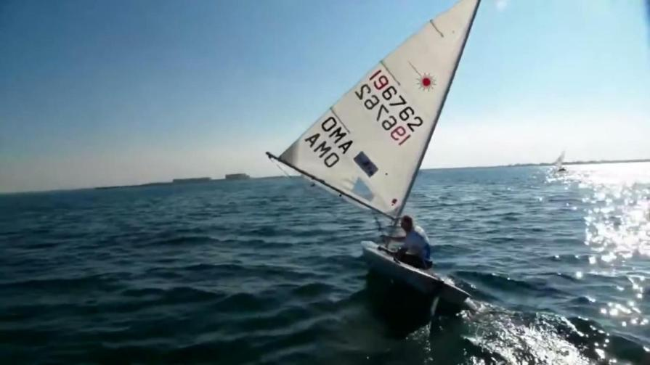
00016

Slide 33
Rock 7 | 42.2(b) | Repeated rolling not linked to wave patterns
00016

Slide 34
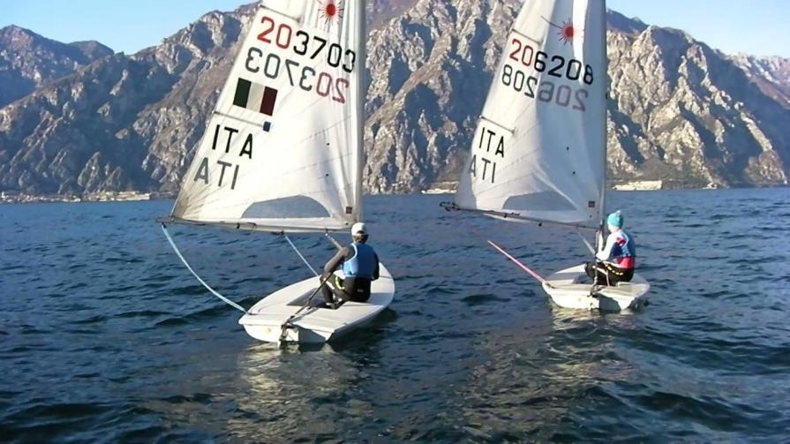
00017

Slide 35
Basic 4 | 42.1 | Except when permitted under rule 42.3, any single action of the body that clearly propels the boat (in any direction) is prohibited.
00017

Slide 36
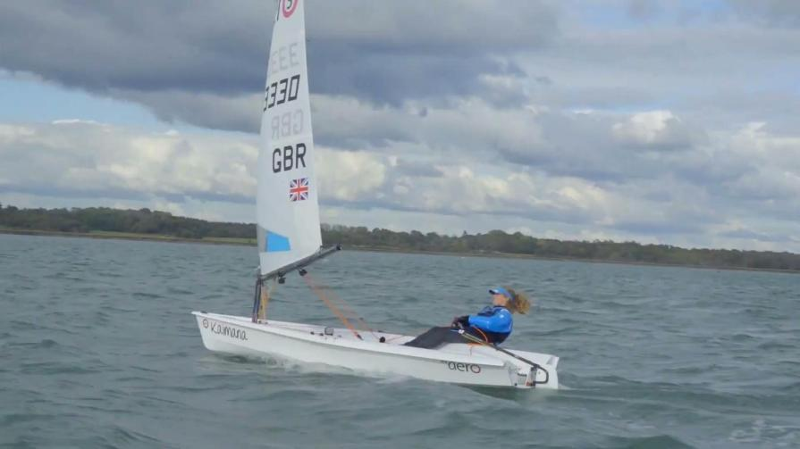
00018

Slide 37
Pump 12 | 42.2(a) | The exception in rule 42.3(c)(1) does not apply to a boat that is already surfing or planing.
00018

Slide 38
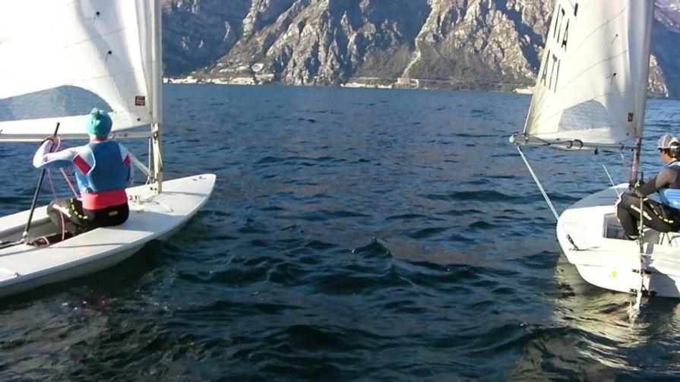
00019

Slide 39
Basic 4 | 42.1 | Except when permitted under rule 42.3, any single action of the body that clearly propels the boat (in any direction) is prohibited.
00019

Slide 40
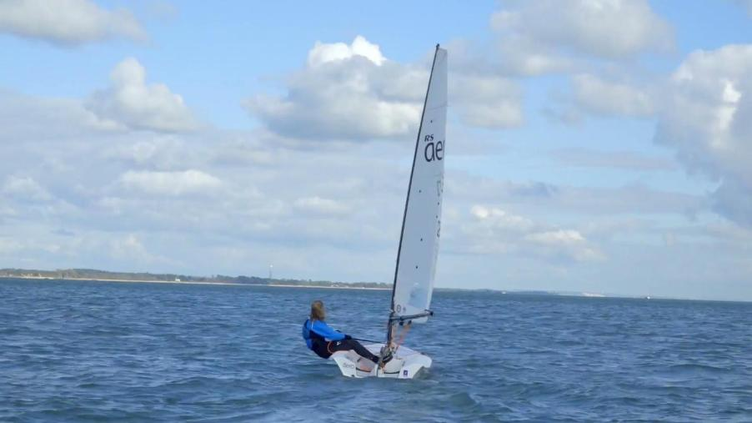
00028

Slide 41
00028

Slide 42
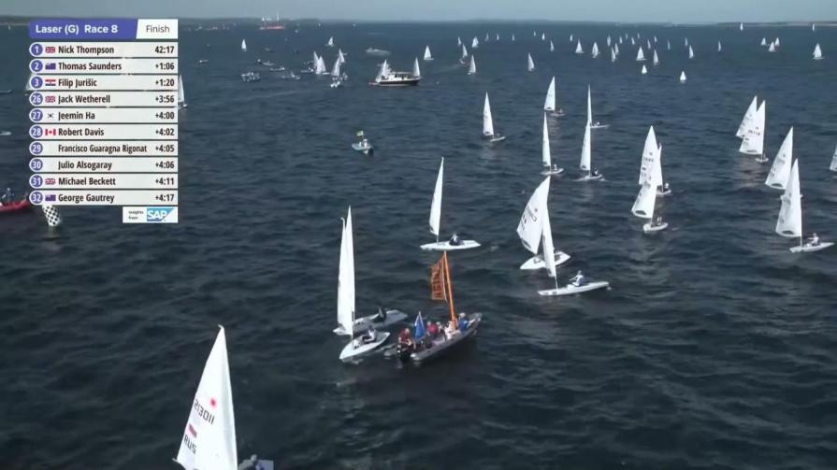
00020

Slide 43
Rock 6 | 42.2(a) | Heeling to windward to facilitate bearing away and heeling to leeward to facilitate heading up are permitted. The heeling of the boat has to be consistent with the boat’s turn.
00020

Slide 44
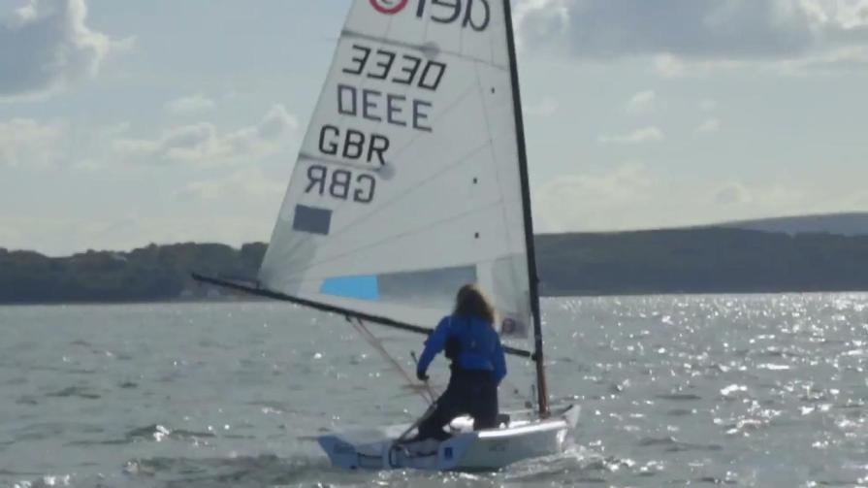
00021

Slide 45
Rock 7 | 42.2(a) | Repeated rolling not linked to wave patterns
00021

Slide 46
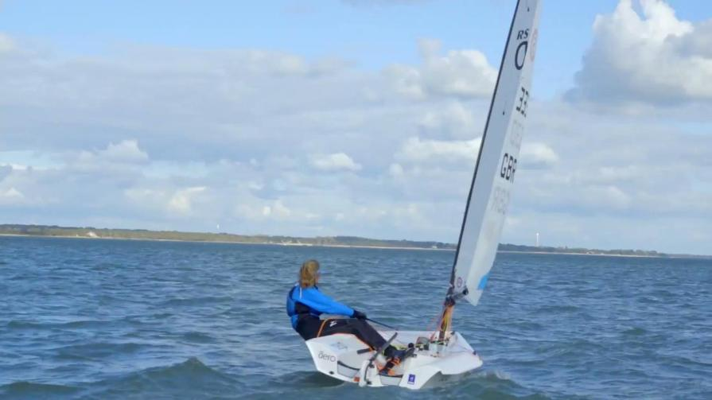
00022

Slide 47
00022

Slide 48
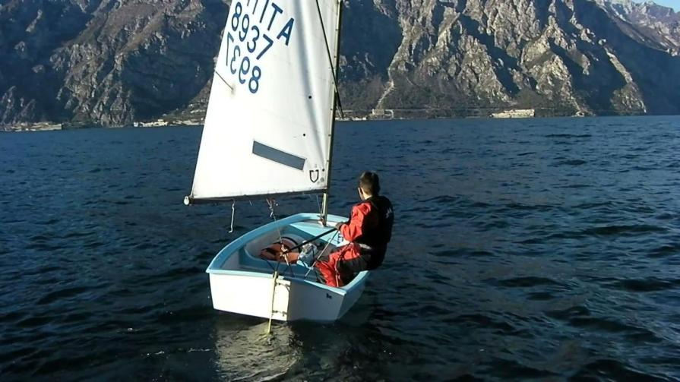
00023

Slide 49
00023

Slide 50
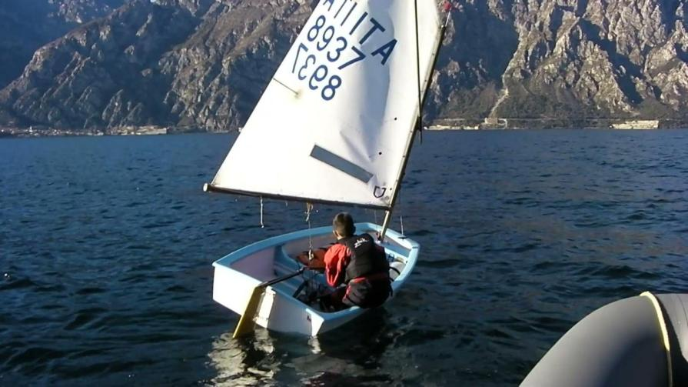
00024

Slide 51
Basic 4 | 42.1 | Except when permitted under 42.3, any single action of the body that clearly propels the boat (in any direction) is prohibited.
00024

Slide 52
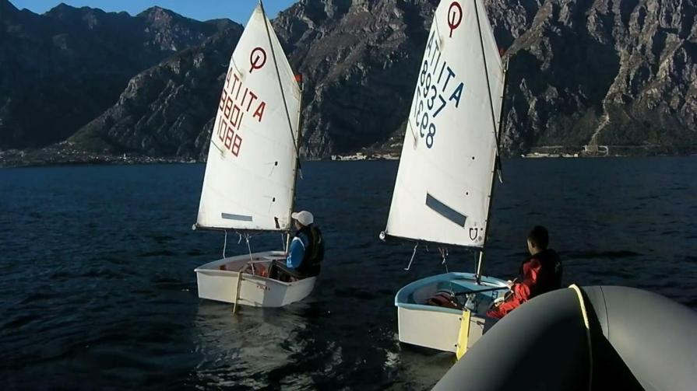
00025

Slide 53
Pump 6 | 42.1 | Repeated flicks of a sail due to body pumping are prohibited.
00025

Slide 54
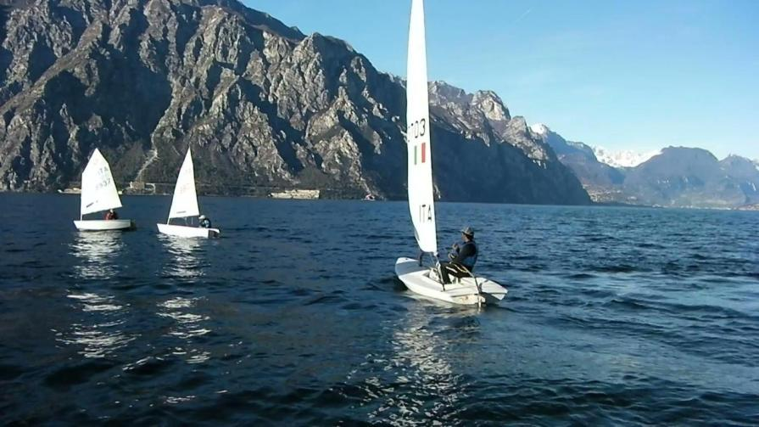
00026

Slide 55
Pump 6 | 42.1 | Repeated flicks of a sail due to body pumping are prohibited.
00026

Slide 56
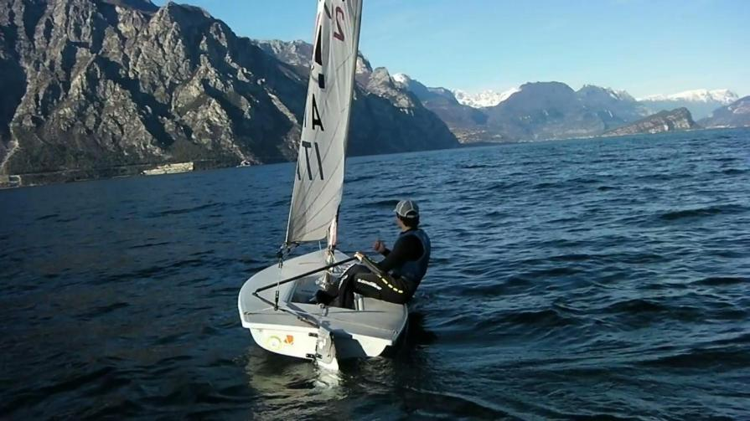
00027

Slide 57
00027

Slide 58
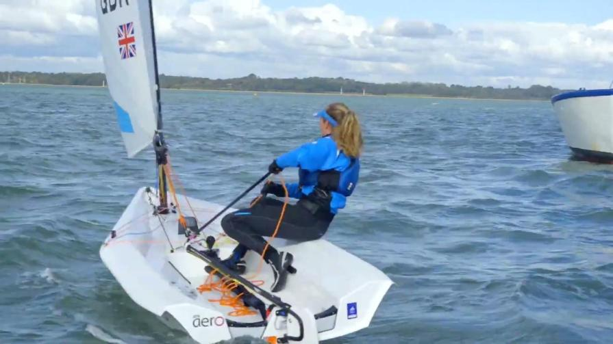
00029

Slide 59
 | 42.2(d) | Sculled below close-hauled.
00029

Slide 60
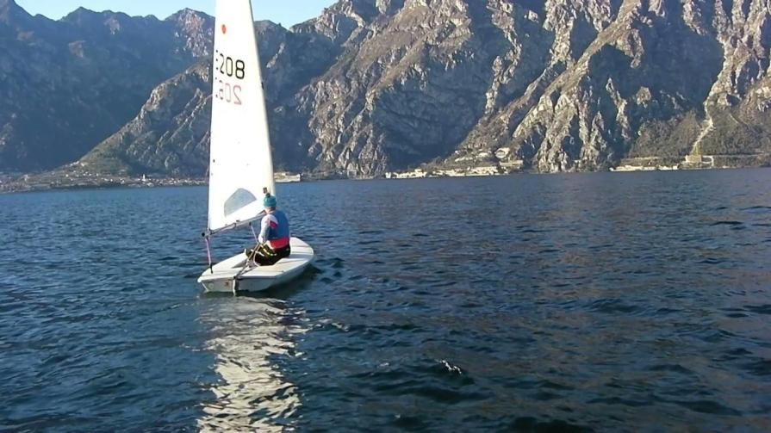
00030

Slide 61
Basic 6 | 42.2 | Repeated flicks of a sail due to body pumping are prohibited.
00030

Slide 62
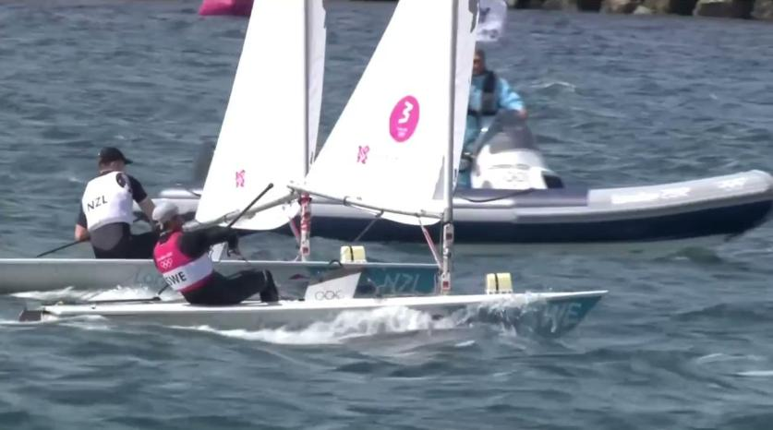
00032

Slide 63
Pump 12 | 42.2(c) | The exception in rule 42.3(c)(1) does not apply to a boat that is already surfing or planing.
00032

Slide 64
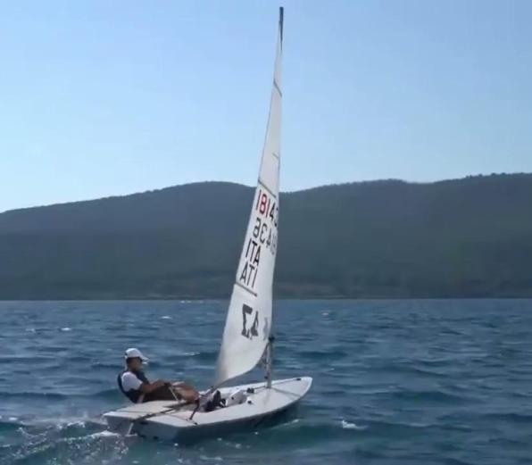
00033

Slide 65
00033

Slide 66
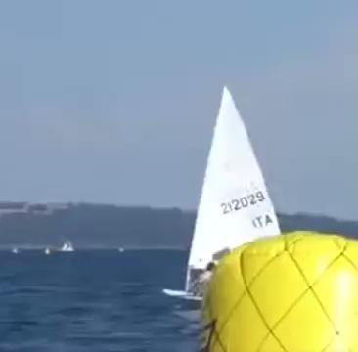
00034

Slide 67
Rock 6 | 42.2(b) | Heeling to windward to facilitate bearing away and heeling to leeward to facilitate heading up are permitted. The heeling of the boat has to be consistent with the boat’s turn
00034

Slide 68
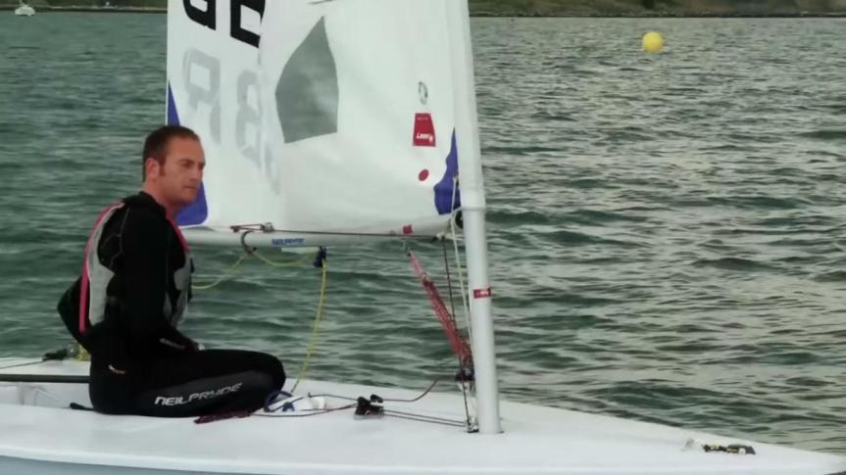
00040

Slide 69
00040

Slide 70
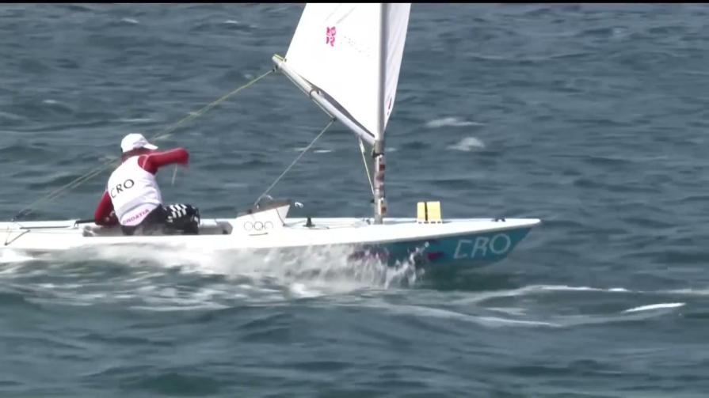
00031

Slide 71
00031

Slide 72
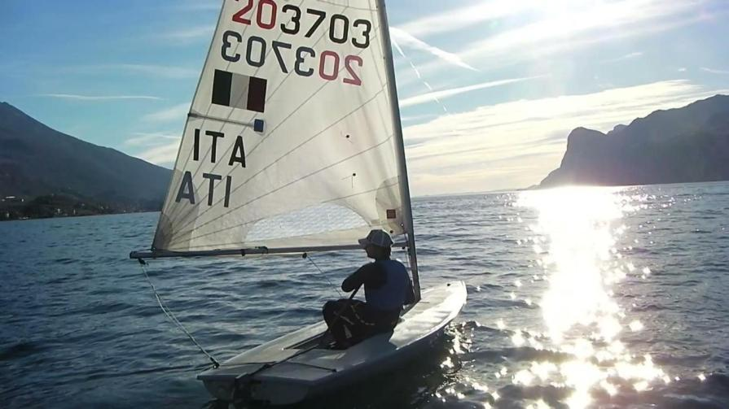
00035

Slide 73
Rock 7 | 42.2(b) | Repeated rolling not linked to wave patterns
00035

Slide 74
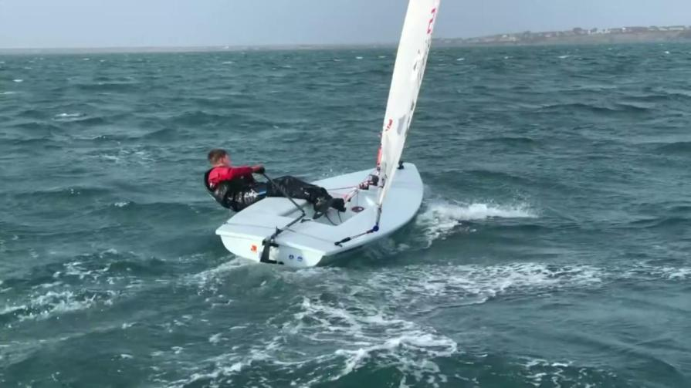
00036

Slide 75
00036

Slide 76
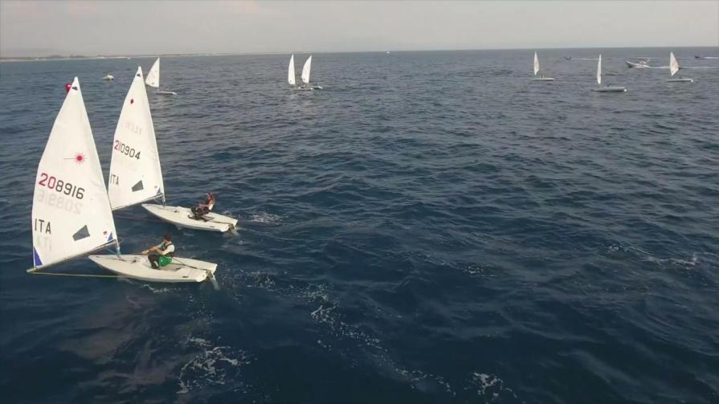
00037

Slide 77
Rock 6 | 42.2(b) | Heeling to windward to facilitate bearing away and heeling to leeward to facilitate heading up are permitted. The heeling of the boat has to be consistent with boat’s turn.
00037

Slide 78
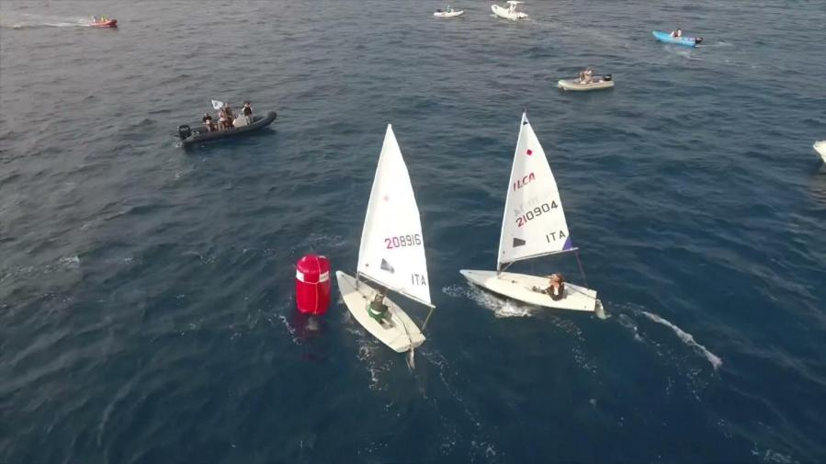
00038

Slide 79
Pump 6 | 42.2(a) | Repeated flicks of a sail due to body pumping are prohibited.
00038

Slide 80
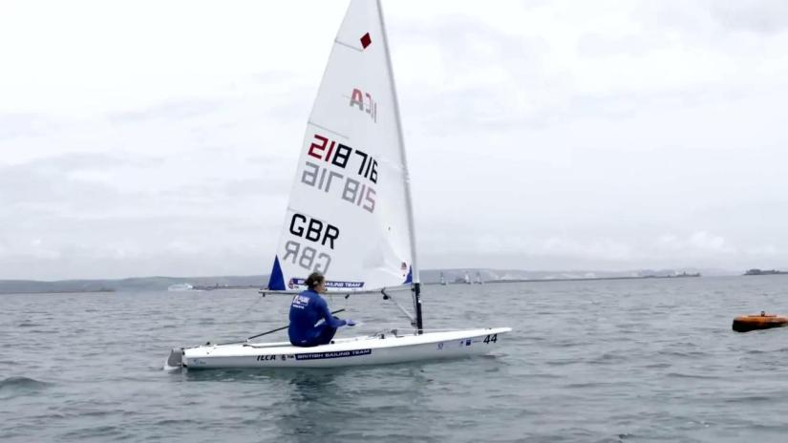
00039

Slide 81
00039

Slide 82
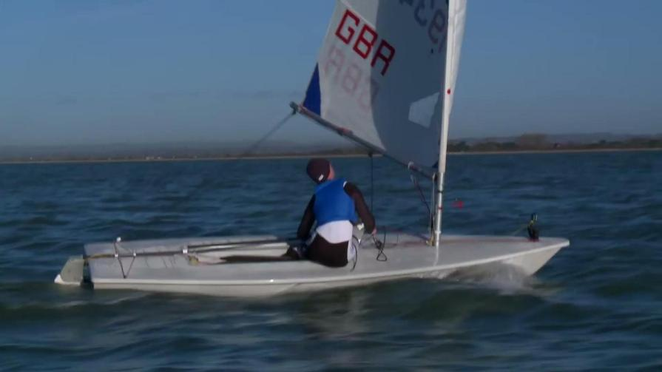
00041

Slide 83
00041

Slide 84
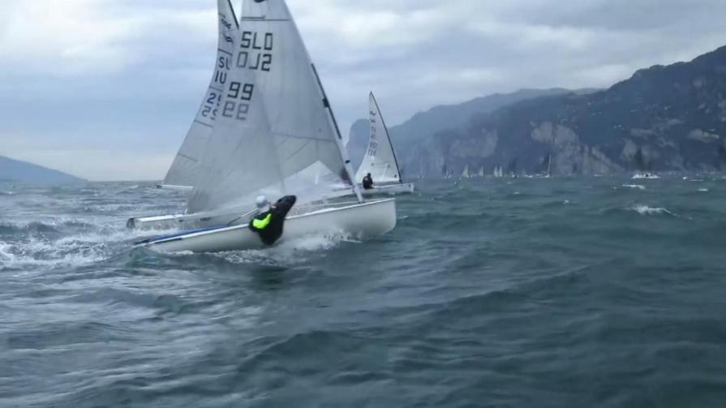
00042

Slide 85
Pump 1 | 42.2(a) | Fanning is moving a sail in and out not in response to wind shifts, gusts or waves.
00042

Slide 86
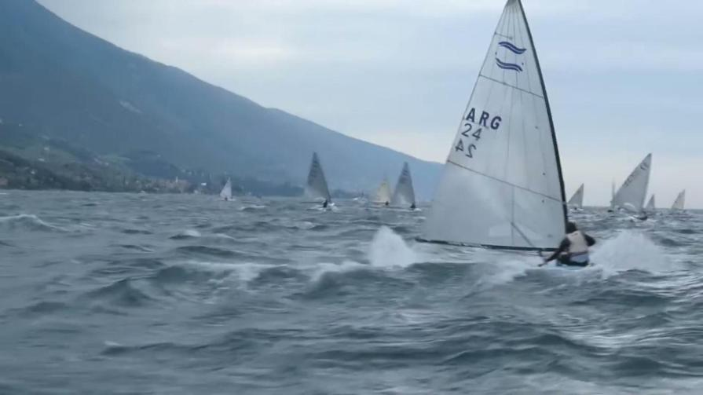
00043

Slide 87
Pump 12 | 42.2(a) | The exception in rule 42.3(c)(1) does not apply to a boat that is already surfing or planing.
00043

Slide 88
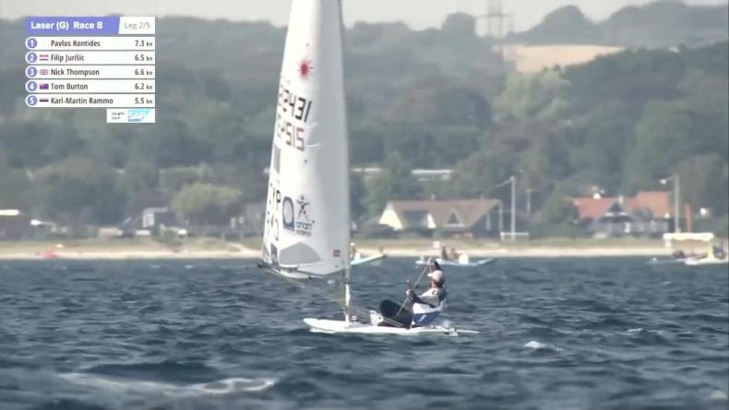
00044

Slide 89
Rock 7 | 42.2(b) | Repeated rolling not linked to wave patterns
00044

Slide 90
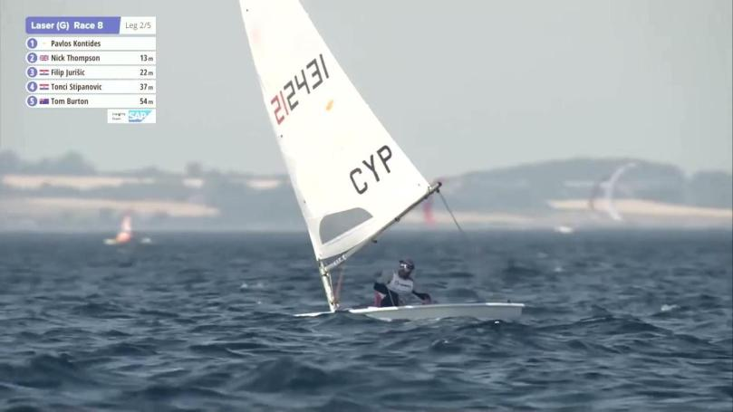
00046

Slide 91
00046

Slide 92
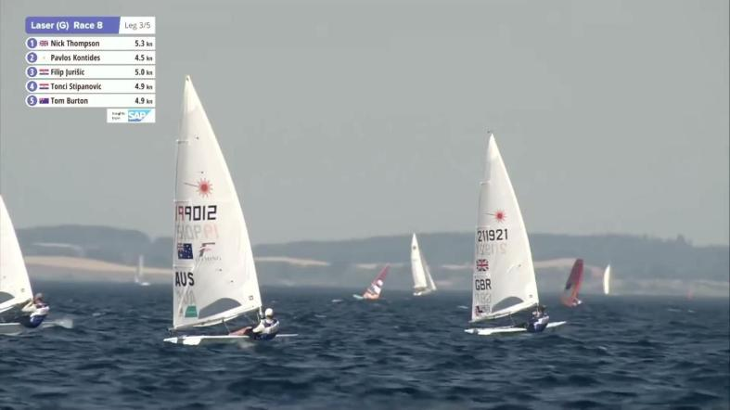
00047

Slide 93
00047

Slide 94
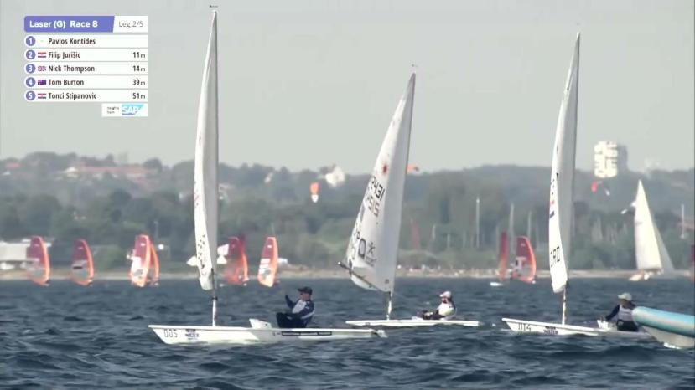
00045

Slide 95
Pump 1 | 42.2(a) | Fanning is moving a sail in and out not in response to wind shifts, gusts or waves.
00045

Slide 96
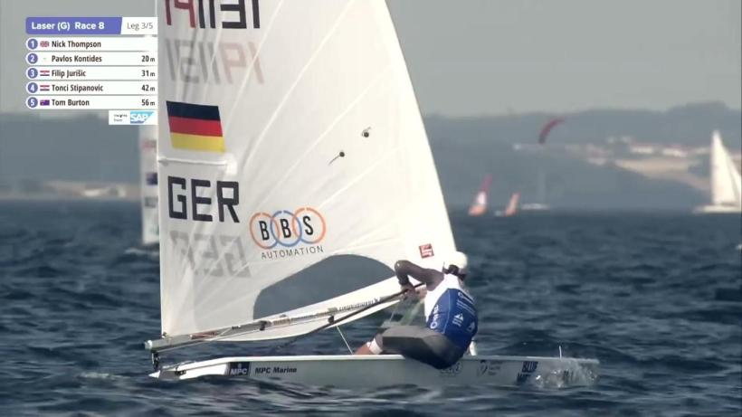
00048

Slide 97
00048

Slide 98
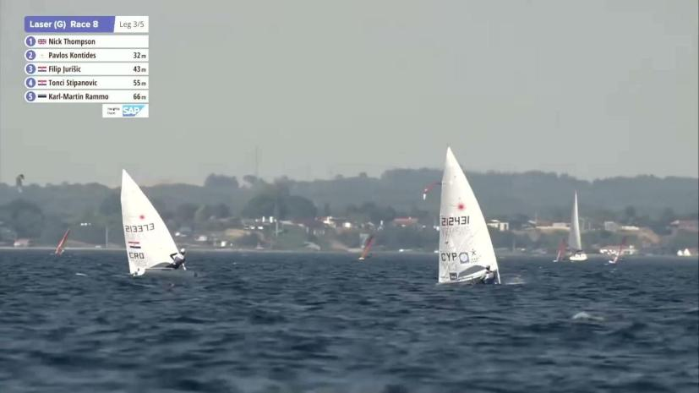
00049

Slide 99
PUMP 3 - 42.2 a - Except when permitted under rule 42.3(c), one pump may be prohibited under rule 42.1.
00049

Slide 100
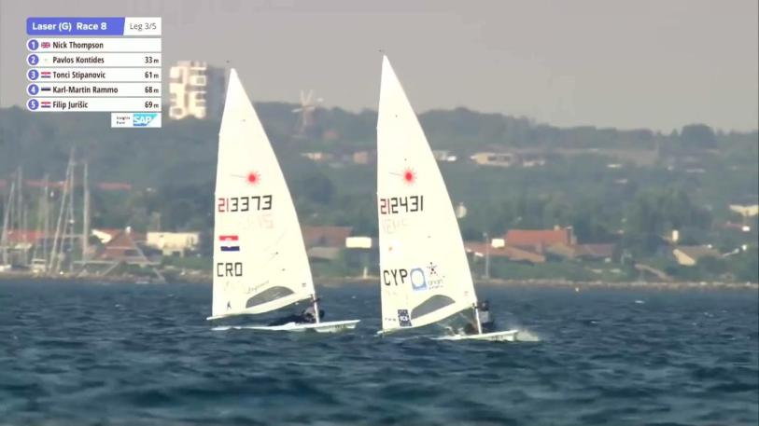
00050

Slide 101
00050

Slide 102
00051

Slide 103
Basic 6 | 42.2 | Repeated flicks of a sail due to body pumping are prohibited.
00051

Slide 104
00135

Slide 105
00135

Slide 106
00053

Slide 107
It is unlikely that a boat in the yellow light area would be penalized, but it is possible. If the action is repeated, the likelihood of a penalty will increase.
00053

Slide 108
00054

Slide 109
00054

Slide 110
00056

Slide 111
Pump 3 | 42.1 | Except when permitted under 42.3(c), one pump may be prohibited under rule 42.1.
00056

Slide 112
00055

Slide 113
00055

Slide 114
00057

Slide 115
Basic 4 | 42.1 | Except when permitted under 42.3, any single action of the body that clearly propels the boat (in any direction) is prohibited.
00057

Slide 116
00058

Slide 117
Pump 1 | 42.2(a) | Fanning is moving a sail in and out not in response to wind shifts, gusts or waves.
00058

Slide 118
00059

Slide 119
Pump 1 | 42.2(a) | Fanning is moving a sail in and out not in response to wind shifts, gusts or waves.
00059

Slide 120
00061

Slide 121
Pump 1 | 42.2(a) | Fanning is moving a sail in and out not in response to wind shifts, gusts or waves.
00061

Slide 122
00064

Slide 123
00064

Slide 124
00060

Slide 125
00060

Slide 126
00063

Slide 127
Pump 12 | 42.2(a) | The exception in rule 42.3(c)(1) does not apply to a boat that is already surfing or planing.
00063

Slide 128
00065

Slide 129
Pump 1 | 42.2(a) | Fanning is moving a sail in and out not in response to wind shifts, gusts or waves.
00065

Slide 130
00066

Slide 131
Pump 1 | 42.2(a) | Fanning is moving a sail in and out not in response to wind shifts, gusts or waves.
00066

Slide 132
00067

Slide 133
Pump 12 | 42.2(a) | The exception in rule 42.3(c)(1) does not apply to a boat that is already surfing or planing.
00067

Slide 134
00069

Slide 135
Basic 6 | 42.1 | Repeated flicks of a sail due to body pumping are prohibited.
00069

Slide 136
00070

Slide 137
Basic 6 | 42.1 | Repeated flicks of a sail due to body pumping are prohibited.
00070

Slide 138
00072

Slide 139
42.2b (1) | rocking, repeated rolling of the boat, induced by body movement
00072

Slide 140
00028

Slide 141
00028

Slide 142
00073

Slide 143
42.2b (1) | rocking, repeated rolling of the boat, induced by body movement
00073

Slide 144
00080

Slide 145
00080

Slide 146
00074

Slide 147
Rock 7 | 42.2(b) | Repeated rolling not linked to wave patterns is rocking prohibited by rule 42.2(b), even if the boat changes course with each r
00074

Slide 148
00076

Slide 149
 | 42.2c | ooching: sudden forward body movement, stopped abruptly;
00076

Slide 150
00077

Slide 151
00077

Slide 152
00078

Slide 153
42.2(d) | sculling: repeated movement of the helm that is either forceful or that propels the boat forward or prevents her from moving as
00078

Slide 154
00079

Slide 155
42.2(d) | sculling: repeated movement of the helm that is either forceful or that propels the boat forward or prevents her from moving as
00079

Slide 156
00081

Slide 157
00081

Slide 158
00062

Slide 159
Pump 1 | 42.2(a) | Fanning is moving a sail in and out not in response to wind shifts, gusts or waves.
00062

Slide 160
00083

Slide 161
 | 42.2(d) | Sculled below close-hauled.
00083

Slide 162
00084

Slide 163
 | 42.2(d) | Sculled below close-hauled.
00084

Slide 164
00085

Slide 165
 | 42.2(d) | Sculled below close-hauled.
00085

Slide 166
00088

Slide 167
00088

Slide 168
00086

Slide 169
 | 42.2(d) | Sculled below close-hauled.
00086

Slide 170
00087

Slide 171
Scull 2 | 42.2(d) | After a boat has sculled in one direction, further connected sculling to offset the first sculling action is prohibited.
00087

Slide 172
00089

Slide 173
Scull 2 | 42.2(d) | After a boat has sculled in one direction, further connected sculling to offset the first sculling action is prohibited.
00089

Slide 174
00092

Slide 175
00092

Slide 176
00090

Slide 177
42.2e | Repeated tacks or gybes unrelated to changes in the wind or to tactical consdierations
00090

Slide 178
00091

Slide 179
Rock 7 | 42.2(b) | Repeated rolling not linked to wave patterns
00091

Slide 180
00094

Slide 181
Basic 4 | 42.1 | Except when permitted under 42.3, any single action of the body that clearly propels the boat (in any direction) is prohibited.
00094

Slide 182
00095

Slide 183
00095

Slide 184
00096

Slide 185
42.2c (3) | ooching: sudden forward body movement, stopped abruptly;
Pump 12 | 42.2(a) | The exception in rule 42.3(c)(1) does not apply to a boat that is already surfing or planing.
00096

Slide 186
00097

Slide 187
00097

Slide 188
00099

Slide 189
Rock 7 | 42.2(b) | Repeated rolling not linked to wave patterns
00099

Slide 190
00098

Slide 191
00098

Slide 192
00100

Slide 193
Rock 7 | 42.2(b) | Repeated rolling not linked to wave patterns
00100

Slide 194
00101

Slide 195
Rock 7 | 42.2(b) | Repeated rolling not linked to wave patterns
00101

Slide 196
00103

Slide 197
00103

Slide 198
00104

Slide 199
Basic 6 | 42.1 | Repeated flicks of a sail due to body pumping are prohibited.
00104

Slide 200
00105

Slide 201
Basic 6 | 42.1 | Repeated flicks of a sail due to body pumping are prohibited.
00105

Slide 202
00108

Slide 203
Pump 3 | 42.1 | Except when permitted under 42.3(c), one pump may be prohibited under rule 42.1.
 | 42.2c ooching: sudden forward body movement, stopped abruptly;
00108

Slide 204
00106

Slide 205
Basic 6 | 42.2 | Repeated flicks of a sail due to body pumping are prohibited.
00106

Slide 206
00107

Slide 207
Basic 6 | 42.2 | Repeated flicks of a sail due to body pumping are prohibited.
00107

Slide 208
00109

Slide 209
Basic 4 | 42.1 | Except when permitted under rule 42.3, any single action of the body that clearly propels the boat (in any direction) is prohib
Rock 8 | 42.1 | Body movements that exaggerate rolling and cause a boat to sail out of a tack or gybe at the same speed as she had just before
00109

Slide 210
00113

Slide 211
Pump 8 | 42.3(c) | If a boat repeats an unsuccessful attempt to plane or surf, she is in the yellow light area. A third consecutive unsuccessful
00113

Slide 212
00114

Slide 213
Pump 12 | 42.2(b) | The exception in rule 42.3(c)(1) does not apply to a boat that is already surfing or planing.
00114

Slide 214
No Oscar
00115

Slide 215
Basic 6 | 42.1 | Repeated flicks of a sail due to body pumping are prohibited.
No Oscar
00115

Slide 216
00117

Slide 217
00117

Slide 218
00093

Slide 219
Basic 4 | 42.1 | Except when permitted under 42.3, any single action of the body that clearly propels the boat (in any direction) is prohibited.
00093

Slide 220
No Oscar
00130

Slide 221
Pump 1 | 42.2(a) | Fanning is moving a sail in and out not in response to wind shifts, gusts or waves.
No Oscar
00130

Slide 222
00122

Slide 223
Pump 1 | 42.2(a) | Fanning is moving a sail in and out not in response to wind shifts, gusts or waves.
00122

Slide 224
00116

Slide 225
Rock 7 | 42.2(b) | Repeated rolling not linked to wave patterns
00116

Slide 226
00118

Slide 227
00118

Slide 228
00119

Slide 229
00119

Slide 230
00120

Slide 231
00120

Slide 232
00121

Slide 233
It is unlikely that a boat in the yellow light area would be penalized, but it is possible. If the action is repeated, the likelihood of a penalty will increase.
00121

Slide 234
00123

Slide 235
00123

Slide 236
00124

Slide 237
Scull 2 | 42.2(d) | After a boat has sculled in one direction, further connected sculling to offset the first sculling action is prohibited.
00124

Slide 238
00125

Slide 239
Basic 6 | 42.1 | Repeated flicks of a sail due to body pumping are prohibited.
00125

Slide 240
00126

Slide 241
00126

Slide 242
00127

Slide 243
 | 42.2(d) | Sculled below close-hauled.
00127

Slide 244
00128

Slide 245
00128

Slide 246
00129

Slide 247
È improbabile che una barca nell'area di semaforo giallo sia penalizzata, ma è possibile. Se l'azione è ripetuta, la probabilità di una penalità aumenta rapidamente.
00129

Slide 248
00131

Slide 249
42.2b (1) | rocking, repeated rolling of the boat, induced by body movement
00131

Slide 250
No Oscar
00132

Slide 251
Basic 4 | 42.1 | Except when permitted under 42.3, any single action of the body that clearly propels the boat (in any direction) is prohibited.
No Oscar
00132

Slide 252
00143

Slide 253
Basic 4 | 42.1 | Except when permitted under 42.3, any single action of the body that clearly propels the boat (in any direction) is prohibited.
00143

Slide 254
00133

Slide 255
Rock 7 | 42.2(b) | Repeated rolling not linked to wave patterns
00133

Slide 256
00134

Slide 257
Basic 4 | 42.1 | Except when permitted under 42.3, any single action of the body that clearly propels the boat (in any direction) is prohibited.
00134

Slide 258
00138

Slide 259
00138

Slide 260
00137

Slide 261
42.2c (3) | Ooching: sudden forward body movement, stopped abruptly;
00137

Slide 262
00139

Slide 263
00139

Slide 264
00140

Slide 265
ROCK 6 - 42.2b - Heeling to windward to facilitate bearing away and heeling to leeward to facilitate heading up are permitted. The heeling of the boat has to be consistent with the boat's turn.
00140

Slide 266
00141

Slide 267
42.2c (3) | ooching: sudden forward body movement, stopped abruptly;
00141

Slide 268
00142

Slide 269
00142

Slide 270
00145

Slide 271
Basic 4 | 42.1 | Except when permitted under 42.3, any single action of the body that clearly propels the boat (in any direction) is prohibited.
00145

Slide 272
00146

Slide 273
Pump 1 | 42.2(a) | Fanning is moving a sail in and out not in response to wind shifts, gusts or waves.
00146

Slide 274
000

Slide 275
00

Slide 276
00

Slide 277
147

Slide 278
147

Slide 279
148

Slide 280
148

Slide 281
149

Slide 282
149

Slide 283
150

Slide 284
150

Slide 285
151

Slide 286
Basic 5 | 42.2 | An action listed in rule 42.2 is always prohibited, even if it fails to propel the boat.
151

Slide 287
152

Slide 288
Pump 6 | 42.2(a) | Repeated flicks of a sail due to body pumping are prohibited.
152

Slide 289
153

Slide 290
153

Slide 291
154

Slide 292
Rock 7 | 42.2(b) | Repeated rolling not linked to wave patterns is rocking prohibited by rule 42.2(b), even if the boat changes course with each roll.
154

Slide 293
155

Slide 294
Pump 6 | 42.2(a) | Repeated flicks of a sail due to body pumping are prohibited.
155

Slide 295
156

Slide 296
 | 42.2(d) | Sculled below close-hauled.
156

Slide 297
157

Slide 298
Rock 7 | 42.2(b) | Repeated rolling not linked to wave patterns is rocking prohibited by rule 42.2(b), even if the boat changes course with each roll.
157

Slide 299
158

Slide 300
Rock 7 | 42.2(b) | Repeated rolling not linked to wave patterns is rocking prohibited by rule 42.2(b), even if the boat changes course with each roll.
158

Slide 301
159

Slide 302
Rock 7 | 42.2(b) | Repeated rolling not linked to wave patterns is rocking prohibited by rule 42.2(b), even if the boat changes course with each roll.
159

Slide 303
160

Slide 304
Pump 1 | 42.2(a) | Fanning is moving a sail in and out not in response to wind shifts, gusts or waves.
160

Slide 305
161

Slide 306
Rock 7 | 42.2(b) | Repeated rolling not linked to wave patterns is rocking prohibited by rule 42.2(b), even if the boat changes course with each roll.
161

Slide 307
162

Slide 308
Rock 7 | 42.2(b) | Repeated rolling not linked to wave patterns is rocking prohibited by rule 42.2(b), even if the boat changes course with each roll.
162

Slide 309
163

Slide 310
42.2b (1) | Rocking, repeated rolling of the boat, induced by body movement.
163

Slide 311
164

Slide 312
42.2(d) | Sculling: repeated movement of the helm that is either forceful or that propels the boat forward or prevents her from moving astern
164

Slide 313
165

Slide 314
42.2(d) | Sculling: repeated movement of the helm that is either forceful or that propels the boat forward or prevents her from moving astern
165

Slide 315
166

Slide 316
42.2e | Repeated tacks or gybes unrelated to changes in the wind or to tactical considerations
166

Slide 317
167

Slide 318
Basic 4 | 42.1 | Any single action of the body that clearly propels the boat (in any direction) is prohibited.
167

Slide 319
168

Slide 320
42.2(d) | Sculling: repeated movement of the helm that is either forceful or that propels the boat forward or prevents her from moving astern.
168

Slide 321
169

Slide 322
Basic 6 | 42.1 | After a tack when a boat in on her new close-hauled course, body movement clearly propelling the boat is prohibited under rule 42.1.
169

Slide 323
170

Slide 324
42.2(a) pumping: repeated fanning of any sail either by pulling in and releasing the sail or by vertical or athwartships body movement.
170

Slide 325
171

Slide 326
42.2(d) | Sculling: repeated movement of the helm that is either forceful or that propels the boat forward or prevents her from moving astern.
171

Slide 327
172

Slide 328
42.2(d) | Sculling: repeated movement of the helm that is either forceful or that propels the boat forward or prevents her from moving astern.
172

Slide 329
173

Slide 330
 | 42.2(d) | Sculled below close-hauled.
173

Slide 331
174

Slide 332
Pump 6 | 42.2(a) | Repeated flicks of a sail due to body pumping are prohibited.
 | 42.2(d) | Sculling: repeated movement of the helm that is either forceful or that propels the boat forward or prevents her from moving astern.
174

Slide 333
175

Slide 334
 | 42.2(d) | Sculled below close-hauled.
175

Slide 335
176

Slide 336
 | 42.2(d) | Sculled below close-hauled.
176

Slide 337
177

Slide 338
42.2(d) | Sculling: repeated movement of the helm that is either forceful or that propels the boat forward or prevents her from moving astern.
177

Slide 339
178

Slide 340
 | 42.2(d) | Sculled below close-hauled.
178

Slide 341
179

Slide 342
180

Slide 343
 | 42.2(d) | Sculling: repeated movement of the helm that is either forceful or that propels the boat forward or prevents her from moving astern.
180

Slide 344
181

Slide 345
 | 42.2(d) | Sculled below close-hauled.
181

Slide 346
182

Slide 347
42.2b (1) | Rocking, repeated rolling of the boat, induced by body movement.
182

Slide 348
183

Slide 349
 | 42.2(d) | Sculling: repeated movement of the helm that is either forceful or that propels the boat forward or prevents her from moving astern.
183

Slide 350
184

Slide 351
 | 42.2(d) | Sculling: repeated movement of the helm that is either forceful or that propels the boat forward or prevents her from moving astern.
184

Slide 352
185

Slide 353
Scull 3 | 42.2(d) | Sculling to offset steering of the boat caused by backing a sail is prohibited.
185

Slide 354
186

Slide 355
Pump 1 | 42.2(a) | Fanning is moving a sail in and out not in response to wind shifts, gusts or waves.
42.2b (1) | Rocking, repeated rolling of the boat, induced by body movement.
186

Slide 356
187

Slide 357
Scull 3 | 42.2(d) | Sculling to offset steering of the boat caused by backing a sail is prohibited.
187

Slide 358
188

Slide 359
Pump 6 | 42.2(a) | Repeated flicks of a sail due to body pumping are prohibited.
188

Slide 360
189

Slide 361
 | 42.2(c) | Ooching: sudden forward body movement, stopped abruptly;
189

Slide 362
190

Slide 363
Scull 3 | 42.2(d) | Sculling to offset steering of the boat caused by backing a sail is prohibited.
190

Slide 364
191

Slide 365
Pump 6 | 42.2(a) | Repeated flicks of a sail due to body pumping are prohibited.
191

Slide 366
192

Slide 367
Basic 6 | 42.1 | After a tack when a boat in on her new close-hauled course, body movement clearly propelling the boat is prohibited under rule 42.1.
192

Slide 368
193

Slide 369
Basic 6 | 42.1 | After a tack when a boat in on her new close-hauled course, body movement clearly propelling the boat is prohibited under rule 42.1.
193

Slide 370
194

Slide 371
Basic 6 | 42.1 | After a tack when a boat in on her new close-hauled course, body movement clearly propelling the boat is prohibited under rule 42.1.
194

Slide 372
195

Slide 373
Pump 6 | 42.2(a) | Repeated flicks of a sail due to body pumping are prohibited.
195

Slide 374
196

Slide 375
42.2e | Repeated tacks or gybes unrelated to changes in the wind or to tactical considerations
196

Slide 376
197

Slide 377
 | 42.2(d) | Sculling: repeated movement of the helm that is either forceful or that propels the boat forward or prevents her from moving astern.
197

Slide 378
198

Slide 379
 | 42.2(d) | Sculled below close-hauled.
198

Slide 380
199

Slide 381
 | 42.2(d) | Sculling: repeated movement of the helm that is either forceful or that propels the boat forward or prevents her from moving astern.
199

Slide 382
200

Slide 383
 | 42.2(d) | Sculled below close-hauled.
200

Slide 384
201

Slide 385
Pump 12 | 42.3(c) | The exception in rule 42.3(c)(1) does not apply to a boat that is already surfing or planing.
201

Slide 386
202

Slide 387
 | 42.2(a) | (a) pumping: repeated fanning of any sail either by pulling in and releasing the sail or by vertical or athwartship body movement;
202

Slide 388
203

Slide 389
203

Slide 390
 | 42.3(e) | Se una stecca è rovesciata, l’equipaggio di una barca può pompare la vela fino a quando la stecca non è più rovesciata. Questa azione non è permessa se dà propulsione.
204

Slide 391
Exeptions | 42.3(e) | If a batten is inverted, the boat’s crewpump the sail untilthe batten is no longer inverted. This action iz not permitted clearly propels the boat.
204

Slide 392
205

Slide 393
 | 42.2(d) | Sculling: repeated movement of the helm that is either forceful or that propels the boat forward or prevents her from moving astern.
205

Slide 394
206

Slide 395
42.2b (1) | Rocking, repeated rolling of the boat, induced by body movement.
206

Slide 396
207

Slide 397
Pump 6 | 42.2(a) | Repeated flicks of a sail due to body pumping are prohibited.
207

Slide 398
208

Slide 399
208

Slide 400
209

Slide 401
209

Slide 402
210

Slide 403
Pump 6 | 42.2(a) | Repeated flicks of a sail due to body pumping are prohibited.
210

Slide 404
211

Slide 405
Pump 6 | 42.2(a) | Repeated flicks of a sail due to body pumping are prohibited.
211

Slide 406
212

Slide 407
Pump 6 | 42.2(a) | Repeated flicks of a sail due to body pumping are prohibited.
212

Slide 408
213

Slide 409
42.2b (1) | Rocking, repeated rolling of the boat, induced by body movement.
213

Slide 410
214

Slide 411
42.2(a) | Ripetuti sventagliamenti della vela ottenuti da movimenti del corpo verticali o trasversali
Basic 4 | 42.1 | Una singola azione chiaramente propulsiva per la barca.
214

Slide 412
215

Slide 413
 | 42.2(d) | Sculled below close-hauled.
215

Slide 414
216

Slide 415
Pump 6 | 42.2(a) | Repeated flicks of a sail due to body pumping are prohibited.
216

Slide 416
217

Slide 417
Pump 6 | 42.2(a) | Repeated flicks of a sail due to body pumping are prohibited.
217

Slide 418
218

Slide 419
Scull 2 | 42.2(d) | After a boat has sculled in one direction, further connected sculling to offset the first sculling action is prohibited.
218

Slide 420
219

Slide 421
 | 42.2(d) | Sculled below close-hauled.
219

Slide 422
220

Slide 423
42.2b (1) | Rocking, repeated rolling of the boat, induced by body movement.
220

Slide 424
221

Slide 425
Pump 1 | 42.2(a) | Fanning is moving a sail in and out not in response to wind shifts, gusts or waves.
221

Slide 426
222

Slide 427
42.2(a) | pumping: repeated fanning of any sail either by pulling in and releasing the sail or by vertical or athwartship body movement;
222

Slide 428
223

Slide 429
42.2(a) | pumping: repeated fanning of any sail either by pulling in and releasing the sail or by vertical or athwartship body movement;
223

Slide 430
224

Slide 431
Pump 6 | 42.2(a) | Repeated flicks of a sail due to body pumping are prohibited.
224

Slide 432
225

Slide 433
Pump 6 | 42.2(a) | Repeated flicks of a sail due to body pumping are prohibited.
225

Slide 434
226

Slide 435
42.2b (1) | Rocking, repeated rolling of the boat, induced by body movement.
226

Slide 436
227

Slide 437
42.2(a) | Repeated flicks of a sail due to body pumping are prohibited.
42.2(d) | Sculling: repeated movement of the helm that is either forceful or that propels the boat forward or prevents her from moving astern.
227

Slide 438
228

Slide 439
42.2 (c) spinta in avanti (ooching): improvvisi movimenti in avanti del corpo, interrotti bruscamente;
228

Slide 440
229

Slide 441
Pump 3 | 42.1 | Except when permitted under 42.3(c), one pump may be prohibited under rule 42.1.
229

Slide 442
230

Slide 443
42.2b (1) | Rocking, repeated rolling of the boat, induced by body movement.
230

Slide 444
231

Slide 445
42.2 (b)-1 Rocking: repeated rolling of the boat, induced by body movement
231

Slide 446
232

Slide 447
42.2 (b)-1 Rocking: repeated rolling of the boat, induced by body movement
232

Slide 448
233

Slide 449
PUMP 6 Repeated flicks of a sail due to body pumping are prohibited.
233

Slide 450
234

Slide 451
42.2 (b)-1 Rocking: repeated rolling of the boat, induced by body movement
234

Slide 452
235

Slide 453
42.2 (b)-1 Rocking: repeated rolling of the boat, induced by body movement
235

Slide 454
236

Slide 455
Basic 6 | 42.1 | After a tack when a boat in on her new close-hauled course, body movement clearly propelling the boat is prohibited under rule 42.1.
236

Slide 456
237

Slide 457
Basic 6 | 42.1 | After a tack when a boat in on her new close-hauled course, body movement clearly propelling the boat is prohibited under rule 42.1.
237

Slide 458
238

Slide 459
Basic 6 | 42.1 | After a tack when a boat in on her new close-hauled course, body movement clearly propelling the boat is prohibited under rule 42.1.
238

Slide 460
239

Slide 461
PUMP 8 - 42.2 a - If a boat repeats an unsuccessful attempt to plane or surf, she is in the yellow light area. A third consecutive unsuccessful attempt is prohibited.
239

Slide 462
240

Slide 463
PUMP 3 - 42.2 a - Except when permitted under rule 42.3(c), one pump may be prohibited under rule 42.1.
240

Slide 464
241

Slide 465
42.2 (b)-1 Rocking: repeated rolling of the boat, induced by body movement
241

Slide 466
242

Slide 467
42.2 (d) Sculling: repeated movement of the helm that is either forceful or that propels the boat forward or prevents her from moving astern;
242

Slide 468
243

Slide 469
42.2(a) pumping: repeated fanning of any sail either by pulling in and releasing the sail or by vertical or athwartships body movement.
243

Slide 470
244

Slide 471
PUMP 6 - 42.2 a - Repeated flicks of a sail due to body pumping are prohibited.
244

Slide 472
245

Slide 473
42.2 (d) Sculling: repeated movement of the helm that is either forceful or that propels the boat forward or prevents her from moving astern;
245

Slide 474
246

Slide 475
PUMP 3 - 42.2 a - Except when permitted under rule 42.3(c), one pump may be prohibited under rule 42.1.
246

Slide 476
247

Slide 477
PUMP 6 - 42.2 a - Repeated flicks of a sail due to body pumping are prohibited.
247

Slide 478
248

Slide 479
42.2 (c) Ooching: sudden forward body movement, stopped abruptly;.
PUMP 6 - 42.2 a - Repeated flicks of a sail due to body pumping are prohibited.
248

Slide 480
249

Slide 481
42.2(a) pompare (pumping): ripetuti sventagliamenti di qualsiasi vela, ottenuti sia cazzando e lascando la vela sia creati da movimenti del corpo verticali o trasversali.
249

Slide 482
250

Slide 483
42.2(a) pompare (pumping): ripetuti sventagliamenti di qualsiasi vela, ottenuti sia cazzando e lascando la vela sia creati da movimenti del corpo verticali o trasversali.
250

Slide 484
251

Slide 485
42.2(a) pompare (pumping): ripetuti sventagliamenti di qualsiasi vela, ottenuti sia cazzando e lascando la vela sia creati da movimenti del corpo verticali o trasversali.
251

Slide 486
252

Slide 487
42.2(a) pompare (pumping): ripetuti sventagliamenti di qualsiasi vela, ottenuti sia cazzando e lascando la vela sia creati da movimenti del corpo verticali o trasversali.
252

Slide 488
253

Slide 489
42.2(a) pompare (pumping): ripetuti sventagliamenti di qualsiasi vela, ottenuti sia cazzando e lascando la vela sia creati da movimenti del corpo verticali o trasversali.
253

Slide 490
254

Slide 491
42.2(a) pompare (pumping): ripetuti sventagliamenti di qualsiasi vela, ottenuti sia cazzando e lascando la vela sia creati da movimenti del corpo verticali o trasversali.
254

Slide 492
255

Slide 493
42.2(a) pompare (pumping): ripetuti sventagliamenti di qualsiasi vela, ottenuti sia cazzando e lascando la vela sia creati da movimenti del corpo verticali o trasversali.
255

Slide 494
256

Slide 495
42.2(a) pompare (pumping): ripetuti sventagliamenti di qualsiasi vela, ottenuti sia cazzando e lascando la vela sia creati da movimenti del corpo verticali o trasversali.
256

Slide 496
257

Slide 497
42.2(a) pompare (pumping): ripetuti sventagliamenti di qualsiasi vela, ottenuti sia cazzando e lascando la vela sia creati da movimenti del corpo verticali o trasversali.
257

Slide 498
258

Slide 499
42.2(a) pompare (pumping): ripetuti sventagliamenti di qualsiasi vela, ottenuti sia cazzando e lascando la vela sia creati da movimenti del corpo verticali o trasversali.
258

Slide 500
259

Slide 501
42.2(a) pompare (pumping): ripetuti sventagliamenti di qualsiasi vela, ottenuti sia cazzando e lascando la vela sia creati da movimenti del corpo verticali o trasversali.
259

Slide 502
260

Slide 503
42.2(a) pompare (pumping): ripetuti sventagliamenti di qualsiasi vela, ottenuti sia cazzando e lascando la vela sia creati da movimenti del corpo verticali o trasversali.
260

Slide 504
261

Slide 505
42.2(a) pompare (pumping): ripetuti sventagliamenti di qualsiasi vela, ottenuti sia cazzando e lascando la vela sia creati da movimenti del corpo verticali o trasversali.
261

Slide 506
262

Slide 507
BASIC 2 È proibita ogni tecnica cinetica non elencata nella regola 42.2 che dia propulsione alla barca e che non sia una delle azioni permesse in base alla regola 42.1.
42.2(a) pompare (pumping): ripetuti sventagliamenti di qualsiasi vela, ottenuti sia cazzando e lascando la vela sia creati da movimenti del corpo verticali o trasversali.
SCULL 2 - 42.2 (d) - Dopo che una barca ha fatto timonella in una direzione, sono proibite ulteriori consecutive timonelle fatte per compensare le prime.del corpo verticali o trasversali.
262

Slide 508
263

Slide 509
PUMP 3 - 42.2(a) - Tranne quando permesso in base alla regola 42.3(c), una pompata può essere vietata in base alla regola 42.1.
263

Slide 510
264

Slide 511
42.2 (b)-1 Rocking: repeated rolling of the boat, induced by body movement
264

Slide 512
265

Slide 513
42.2 (b)-1 Rocking: repeated rolling of the boat, induced by body movement
265

Slide 514
266

Slide 515
42.2 (b)-1 Rocking: repeated rolling of the boat, induced by body movement
266

Slide 516
267

Slide 517
42.2 (b)-1 Rocking: repeated rolling of the boat, induced by body movement
267

Slide 518
268

Slide 519
42.2 (b)-1 Rocking: repeated rolling of the boat, induced by body movement
268

Slide 520
269

Slide 521
42.2 (b)-1 Rocking: repeated rolling of the boat, induced by body movement
269

Slide 522
270

Slide 523
PUMP 1 - 42.2 a - Fanning is moving a sail in and out not in response to wind shifts, gusts or waves.
270

Slide 524
271

Slide 525
42.2 (b)-1 Rocking: repeated rolling of the boat, induced by body movement
271

Slide 526
272

Slide 527
42.2 (b)-1 Rocking: repeated rolling of the boat, induced by body movement
272

Slide 528
273

Slide 529
42.2(a) pumping: repeated fanning of any sail either by pulling in and releasing the sail or by vertical or athwartships body movement.
273

Slide 530
274

Slide 531
42.2(a) pompare (pumping): ripetuti sventagliamenti di qualsiasi vela, ottenuti sia cazzando e lascando la vela sia creati da movimenti del corpo verticali o trasversali.
274

Slide 532
275s

Slide 533
42.2(a) pumping: repeated fanning of any sail either by pulling in and releasing the sail or by vertical or athwartships body movement.
275s

Slide 534
276s

Slide 535
ROCK 7 - 42.2b - Repeated rolling not linked to wave patterns is rocking prohibited by rule 42.2(b), even if the boat changes course with each roll.
276s

Slide 536
277s

Slide 537
277s

Slide 538
278s

Slide 539
PUMP 6 - 42.2 a - Repeated flicks of a sail due to body pumping are prohibited.
278s

Slide 540
279s

Slide 541
SCULL 2 - 42.2 d - After a boat has sculled in one direction, further connected sculling to offset the first sculling action is prohibited.
279s

Slide 542
280s

Slide 543
PUMP 6 - 42.2 a - Repeated flicks of a sail due to body pumping are prohibited
280s

Slide 544
281s

Slide 545
PUMP 6 - 42.2 a - Repeated flicks of a sail due to body pumping are prohibited.
281s

Slide 546
282s

Slide 547
PUMP 6 - 42.2 a - Repeated flicks of a sail due to body pumping are prohibited.
SCULL 2 - 42.2 d - After a boat has sculled in one direction, further connected sculling to offset the first sculling action is prohibited.
282s

Slide 548
283s

Slide 549
PUMP 6 - 42.2 a - Repeated flicks of a sail due to body pumping are prohibited.
SCULL 2 - 42.2 d - After a boat has sculled in one direction, further connected sculling to offset the first sculling action is prohibited.
283s

Slide 550
284s

Slide 551
PUMP 3 - 42.2 a - Except when permitted under rule 42.3(c), one pump may be prohibited under rule 42.1.
284s

Slide 552
PUMP 3 - 42.2 a - Except when permitted under rule 42.3(c), one pump may be prohibited under rule 42.1.
285s

Slide 553
285s

Slide 554
286s

Slide 555
PUMP 6 - 42.2 a - Repeated flicks of a sail due to body pumping are prohibited.
286s

Slide 556
287s

Slide 557
PUMP 6 - 42.2 a - Repeated flicks of a sail due to body pumping are prohibited.
287s

Slide 558
288s

Slide 559
PUMP 6 - 42.2 a - Repeated flicks of a sail due to body pumping are prohibited.
SCULL 2 - 42.2 d - After a boat has sculled in one direction, further connected sculling to offset the first sculling action is prohibited.
288s

Slide 560
289s

Slide 561
PUMP 6 - 42.2 a - Repeated flicks of a sail due to body pumping are prohibited.
289s

Slide 562
290s

Slide 563
ROCK 7 - 42.2b - Repeated rolling not linked to wave patterns is rocking prohibited by rule 42.2(b), even if the boat changes course with each roll.
290s

Slide 564
291s

Slide 565
PUMP 1 - 42.2 a - Fanning is moving a sail in and out not in response to wind shifts, gusts or waves.
291s

Slide 566
292s

Slide 567
292s

Slide 568
293s

Slide 569
293s

Slide 570
PUMP 1 - 42.2 a - Fanning is moving a sail in and out not in response to wind shifts, gusts or waves.
294s

Slide 571
295s

Slide 572
295s

Slide 573
296s

Slide 574
296s

Slide 575
297s

Slide 576
297s

Slide 577
298s

Slide 578
298s

Slide 579
299s

Slide 580
299s

Slide 581
300s

Slide 582
BASIC 6 - 42.1 After a tack when a boat in on her new close-hauled course, body movement clearly propelling the boat is prohibited under rule 42.1.
300s

Slide 583
301s

Slide 584
PUMP 1 - 42.2 a - Fanning is moving a sail in and out not in response to wind shifts, gusts or waves.
301s

Slide 585
302s

Slide 586
302s

Slide 587
303

Slide 588
BASIC 6 - 42.1 After a tack when a boat in on her new close-hauled course, body movement clearly propelling the boat is prohibited under rule 42.1.
303

Slide 589
304

Slide 590
BASIC 6 - 42.1 After a tack when a boat in on her new close-hauled course, body movement clearly propelling the boat is prohibited under rule 42.1.
304

Slide 591
303

Slide 592
BASIC 6 - 42.1 After a tack when a boat in on her new close-hauled course, body movement clearly propelling the boat is prohibited under rule 42.1.
PUMP 3 - 42.2 a - Except when permitted under rule 42.3(c), one pump may be prohibited under rule 42.1
SCULL 2 - 42.2 d - After a boat has sculled in one direction, further connected sculling to offset the first sculling action is prohibited.
303

Slide 593
306

Slide 594
BASIC 4 Except when permitted under rule 42.3, any single action of the body that clearly propels the boat (in any direction) is prohibited.
306

Slide 595
307

Slide 596
BASIC 4 Except when permitted under rule 42.3, any single action of the body that clearly propels the boat (in any direction) is prohibited.
307

Slide 597
308

Slide 598
BASIC 4 Except when permitted under rule 42.3, any single action of the body that clearly propels the boat (in any direction) is prohibited.
308

Slide 599
309

Slide 600
PUMP 6 - 42.2 a - Repeated flicks of a sail due to body pumping are prohibited
309

Slide 601
310

Slide 602
SCULL 2 - 42.2 d - After a boat has sculled in one direction, further connected sculling to offset the first sculling action is prohibited.
310

Slide 603
311

Slide 604
42.2 (c) Ooching: sudden forward body movement, stopped abruptly
311

Slide 605
312

Slide 606
SCULL 2 - 42.2 d - After a boat has sculled in one direction, further connected sculling to offset the first sculling action is prohibited.
312

Slide 607
313

Slide 608
PUMP 6 - 42.2 a - Repeated flicks of a sail due to body pumping are prohibited.
313

Slide 609
314

Slide 610
SCULL 2 - 42.2 d - After a boat has sculled in one direction, further connected sculling to offset the first sculling action is prohibited.
314

Slide 611
315

Slide 612
SCULL 2 - 42.2 d - After a boat has sculled in one direction, further connected sculling to offset the first sculling action is prohibited.
315

Slide 613
316

Slide 614
42.2(a) pumping: repeated fanning of any sail either by pulling in and releasing the sail or by vertical or athwartships body movement.
42.2 (d) Sculling: repeated movement of the helm that is either forceful or that propels the boat forward or prevents her from moving astern;
316

Slide 615
317

Slide 616
PUMP 3 - 42.2 a - Except when permitted under rule 42.3(c), one pump may be prohibited under rule 42.1.
317

Slide 617
318

Slide 618
318

Slide 619
318

Slide 620
PPUMP 12 - 42.2 a - The exception in rule 42.3(c)(1) does not apply to a boat that is already surfing or planing.
319

Slide 621
320

Slide 622
42.2 (c) Ooching: sudden forward body movement, stopped abruptly;
320

Slide 623
322

Slide 624
PPUMP 12 - 42.2 a - The exception in rule 42.3(c)(1) does not apply to a boat that is already surfing or planing.
322

Slide 625
323

Slide 626
PUMP 6 - 42.2 a - Repeated flicks of a sail due to body pumping are prohibited.
323

Slide 627
324

Slide 628
PUMP 6 - 42.2 a - Repeated flicks of a sail due to body pumping are prohibited.
324

Slide 629
325

Slide 630
BASIC 6 - 42.1 After a tack when a boat in on her new close-hauled course, body movement clearly propelling the boat is prohibited under rule 42.1.
325

Slide 631
326

Slide 632
42.2 (b)-1 Rocking: repeated rolling of the boat, induced by body movement.
326

Slide 633
327

Slide 634
42.2 (b)-1 Rocking: repeated rolling of the boat, induced by body movement.
327

Slide 635
328

Slide 636
42.2 (b)-1 Rocking: repeated rolling of the boat, induced by body movement.
328

Slide 637
329

Slide 638
42.2 (b)-1 Rocking: repeated rolling of the boat, induced by body movement.
329

Slide 639
330

Slide 640
BASIC 6 - 42.1 After a tack when a boat in on her new close-hauled course, body movement clearly propelling the boat is prohibited under rule 42.1.
330

Slide 641
331

Slide 642
42.2 (b)-1 Rocking: repeated rolling of the boat, induced by body movement.
331

Slide 643
332

Slide 644
PUMP 6 - 42.2 a - Repeated flicks of a sail due to body pumping are prohibited.
332

Slide 645
333

Slide 646
PUMP 6 - 42.2 a - Repeated flicks of a sail due to body pumping are prohibited.
333

Slide 647
334

Slide 648
PUMP 6 - 42.2 a - Repeated flicks of a sail due to body pumping are prohibited.
334

Slide 649
335

Slide 650
42.2 (b)-1 Rocking: repeated rolling of the boat, induced by body movement.
335

Slide 651
336

Slide 652
42.2(b).1 Dondolare (rocking): rollio ripetuto della barca, prodotto da movimenti del corpo
336

Slide 653
337

Slide 654
42.2 (b)-1 Rocking: repeated rolling of the boat, induced by body movement.
337

Slide 655
338

Slide 656
42.2 (b)-1 Rocking: repeated rolling of the boat, induced by body movement.
338

Slide 657
339

Slide 658
42.2 (b)-1 Rocking: repeated rolling of the boat, induced by body movement.
339

Slide 659
340

Slide 660
42.2 (b)-1 Rocking: repeated rolling of the boat, induced by body movement.
340

Slide 661
341

Slide 662
PUMP 6 - 42.2 a - Repeated flicks of a sail due to body pumping are prohibited.
341

Slide 663
332

Slide 664
PUMP 6 - 42.2 a - Repeated flicks of a sail due to body pumping are prohibited.
332

Slide 665
343

Slide 666
343

Slide 667
344

Slide 668
ROCK 7 - 42.2b - Repeated rolling not linked to wave patterns is rocking prohibited by rule 42.2(b), even if the boat changes course with each roll.
344

Slide 669
345

Slide 670
ROCK 7 - 42.2b - Repeated rolling not linked to wave patterns is rocking prohibited by rule 42.2(b), even if the boat changes course with each roll.
345

Slide 671
346

Slide 672
346

Slide 673
347

Slide 674
PUMP 6 - 42.2 a - Repeated flicks of a sail due to body pumping are prohibited.
347

Slide 675
348

Slide 676
PUMP 6 - 42.2 a - Repeated flicks of a sail due to body pumping are prohibited.
348

Slide 677
349

Slide 678
PUMP 6 - 42.2 a - Repeated flicks of a sail due to body pumping are prohibited.
349

Slide 679
350

Slide 680
350

Slide 681
351

Slide 682
PUMP 6 - 42.2 a - Repeated flicks of a sail due to body pumping are prohibited.
351

Slide 683
352

Slide 684
PUMP 6 - 42.2 a - Repeated flicks of a sail due to body pumping are prohibited.
352

Slide 685
353

Slide 686
PUMP 1 - 42.2 a - Fanning is moving a sail in and out not in response to wind shifts, gusts or waves.
353

Slide 687
354

Slide 688
PUMP 6 - 42.2 a - Repeated flicks of a sail due to body pumping are prohibited.
354

Slide 689
355

Slide 690
PUMP 1 - 42.2 a - Fanning is moving a sail in and out not in response to wind shifts, gusts or waves.
355

Slide 691
356

Slide 692
SCULL 3 - 42.2 d - Sculling to offset steering of the boat caused by backing a sail is prohibited.
356

Slide 693
357

Slide 694
357

Slide 695
358

Slide 696
42.2(a) pumping: repeated fanning of any sail either by pulling in and releasing the sail or by vertical or athwartships body movement.
358

Slide 697
359

Slide 698
359

Slide 699
360

Slide 700
42.2(a) pumping: repeated fanning of any sail either by pulling in and releasing the sail or by vertical or athwartships body movement.
360

Slide 701
361

Slide 702
42.2(a) pumping: repeated fanning of any sail either by pulling in and releasing the sail or by vertical or athwartships body movement.
361

Slide 703
362

Slide 704
42.2 (d) Sculling: repeated movement of the helm that is either forceful or that propels the boat forward or prevents her from moving astern;
362

Slide 705
363

Slide 706
PUMP 1 - 42.2 a - Fanning is moving a sail in and out not in response to wind shifts, gusts or waves.
42.2 (d) Sculling: repeated movement of the helm that is either forceful or that propels the boat forward or prevents her from moving astern;
ROCK 7 - 42.2b - Repeated rolling not linked to wave patterns is rocking prohibited by rule 42.2(b), even if the boat changes course with each roll.
363

Slide 707
364

Slide 708
PUMP 1 - 42.2 a - Fanning is moving a sail in and out not in response to wind shifts, gusts or waves.
PUMP 6 - 42.2 a - Repeated flicks of a sail due to body pumping are prohibited.
ROCK 7 - 42.2b - Repeated rolling not linked to wave patterns is rocking prohibited by rule 42.2(b), even if the boat changes course with each roll.
364

Slide 709
365

Slide 710
42.2 (d) Sculling: repeated movement of the helm that is either forceful or that propels the boat forward or prevents her from moving astern;
365

Slide 711
366

Slide 712
42.2 (d) Sculling: repeated movement of the helm that is either forceful or that propels the boat forward or prevents her from moving astern;
42.2(a) pumping: repeated fanning of any sail either by pulling in and releasing the sail or by vertical or athwartships body movement.
366

Slide 713
367

Slide 714
42.2 (d) Sculling: repeated movement of the helm that is either forceful or that propels the boat forward or prevents her from moving astern;
42.2(a) pumping: repeated fanning of any sail either by pulling in and releasing the sail or by vertical or athwartships body movement.
367

Slide 715
368

Slide 716
42.2 (d) Sculling: repeated movement of the helm that is either forceful or that propels the boat forward or prevents her from moving astern;
42.2(a) pumping: repeated fanning of any sail either by pulling in and releasing the sail or by vertical or athwartships body movement.
368

Slide 717
369

Slide 718
42.2 (d) Timonella (sculling): movimento ripetuto del timone che sia fatto con forza o che serva a far avanzare la barca o che ne impedisca il movimento all’indietro.
42.2(a) pumping: repeated fanning of any sail either by pulling in and releasing the sail or by vertical or athwartships body movement..
369

Slide 719
370

Slide 720
42.2(a) pumping: repeated fanning of any sail either by pulling in and releasing the sail or by vertical or athwartships body movement.
370

Slide 721
371

Slide 722
42.2(a) pumping: repeated fanning of any sail either by pulling in and releasing the sail or by vertical or athwartships body movement.
371

Slide 723
372

Slide 724
42.2(a) pumping: repeated fanning of any sail either by pulling in and releasing the sail or by vertical or athwartships body movement.
372

Slide 725
373

Slide 726
42.2(a) pumping: repeated fanning of any sail either by pulling in and releasing the sail or by vertical or athwartships body movement
373

Slide 727
374

Slide 728
42.2(a) pumping: repeated fanning of any sail either by pulling in and releasing the sail or by vertical or athwartships body movement.
374

Slide 729
375

Slide 730
42.2(a) pompare (pumping): ripetuti sventagliamenti di qualsiasi vela, ottenuti sia cazzando e lascando la vela sia creati da movimenti del corpo verticali o trasversali.
375

Slide 731
376

Slide 732
BASIC 6 - 42.1 After a tack when a boat in on her new close-hauled course, body movement clearly propelling the boat is prohibited under rule 42.1.
376

Slide 733
377

Slide 734
42.2 (b)-1 Rocking: repeated rolling of the boat, induced by body movement.
377

Slide 735
378

Slide 736
PUMP 3 - 42.2 a - Except when permitted under rule 42.3(c), one pump may be prohibited under rule 42.1.
378

Slide 737
379

Slide 738
42.2 (b)-1 Rocking: repeated rolling of the boat, induced by body movement.
379

Slide 739
380

Slide 740
42.2(b).1 Dondolare (rocking): rollio ripetuto della barca, prodotto da movimenti del corpo
380

Slide 741
381

Slide 742
BASIC 6 - 42.1 After a tack when a boat in on her new close-hauled course, body movement clearly propelling the boat is prohibited under rule 42.1.
381

Slide 743
382

Slide 744
PUMP 3 - 42.2 a - Except when permitted under rule 42.3(c), one pump may be prohibited under rule 42.1.
382

Slide 745
S
It continues... with videos from next races.
Return to the beginning
This presentation was written by Ezio Fonda. The videos in this Power Point have been made by the author, by colleagues or taken from publicly accessible websites. If a competitor wants to remove a video which they are in, please send an email to www@eziofonda.it

Slide 746
BASIC RULE
BASIC 2 - 42.1 A kinetic technique not listed in rule 42.2 that propels the boat, and is not one of the permitted actions covered in rule 42.1, is prohibited.
BASIC 4 Except when permitted under rule 42.3, any single action of the body that clearly propels the boat (in any direction) is prohibited.
BASIC 6 - 42.1 After a tack when a boat in on her new close-hauled course, body movement clearly propelling the boat is prohibited under rule 42.1.
BASIC 7 - 42.1 - When the speed of a boat clearly drops after she accelerates out of a tack or a gybe, and there is no obvious change of wind speed or direction, the exception in rule 42.3(b) does not apply and the boat breaks rule 42.1
PUMPING
42.2(a) pumping: repeated fanning of any sail either by pulling in and releasing the sail or by vertical or athwartships body movement.
PUMP 1 - 42.2 a - Fanning is moving a sail in and out not in response to wind shifts, gusts or waves.
PUMP 3 - 42.2 a - Except when permitted under rule 42.3(c), one pump may be prohibited under rule 42.1.
PUMP 6 - 42.2 a - Repeated flicks of a sail due to body pumping are prohibited.
PUMP 8 - 42.2 a - If a boat repeats an unsuccessful attempt to plane or surf, she is in the yellow light area. A
third consecutive unsuccessful attempt is prohibited.
PUMP 12 - 42.2 a - The exception in rule 42.3(c)(1) does not apply to a boat that is already surfing or planing.
ROCKING
42.2 (b)-1 Rocking: repeated rolling of the boat, induced by body movement.

Slide 747
42.2 (b)-2 Rocking: repeated rolling of the boat, induced by repeated adjustment of the sails or centreboard
42.2 (b)-3 Rocking: repeated rolling of the boat, induced by steering
ROCK 5 - 42.2b - single body movement that is immediately followed by repeated rolling of the boat is prohibited.
ROCK 6 - 42.2b - Heeling to windward to facilitate bearing away and heeling to leeward to facilitate heading up are permitted. The heeling of the boat has to be consistent with the boat's turn.
ROCK 7 - 42.2b - Repeated rolling not linked to wave patterns is rocking prohibited by rule 42.2(b), even if the boat changes course with each roll.
OOCHING
42.2 (c) Ooching: sudden forward body movement, stopped abruptly;
OOCH 2 - 42.2 c - Torquing on flat water is prohibited.
SCULLING
42.2 (d) Sculling: repeated movement of the helm that is either forceful or that propels the boat forward or prevents her from moving astern;
SCULL 2 - 42.2 d - After a boat has sculled in one direction, further connected sculling to offset the first sculling action is prohibited.
SCULL 3 - 42.2 d - Sculling to offset steering of the boat caused by backing a sail is prohibited.
TACKS/GYBES
42.2 (e) Repeated tacks or gybes unrelated to changes in the wind or to tactical considerations.

Slide 748
Waiting for the video to download
165

Slide 749
Waiting for the video to download
165

Slide 750
Waiting for the video to download
165

